Slide 1
IBM Watson Knowledge Catalog
An intelligent, integrated enterprise data catalog and data governance platform
Auto Profiling
Quality and Anonymization
Data Governance
Tags & Business terms
Users
Policy & Rules
Data Quality Analysts
Data Stewards/Architects
Business Analysts
Data Engineer
Data Scientists
Column Classifiers (160+)
Search and Explore
Notes:
IBM® Watson® Knowledge Catalog provides a unified data catalog for your enterprise that enables you to collect, govern and activate vast amounts of data across multiple sources. Plus, you can keep your data on your own platform—no migrations or uploads needed to achieve an automated, multicloud experience. It empowers enterprises to discover, catalog, and activate their data in order to realize faster time-to-value for their AI and data analysis.
Interactively discover, cleanse and prepare your data, understanding data quality and distribution: With a built in data refinery, it provides a rich set of capabilities that not only allow you to discover, cleanse, and transform your data with built-in operations, but it also comes with powerful profiling and visualization tools such as charts and graphs to help you interact with and understand your data. Data access and transform policies defined in Watson Knowledge Catalog are also enforced in Data Refinery to ensure that sensitive data that originated from governed catalogs remain protected.
Intelligent recommendations for discovering relevant assets quicker across the organization: Watson Knowledge Catalog allows data assets to be easily indexed and classified. Intelligent search algorithms can quickly guide your data scientists and business analysts to find the best data assets for their purpose thereby helping them to spend less time looking for data, and more time building AI and data science applications.
Protect data & AI model misuse and confidently share assets based on organizational policies: Uses active policy enforcement and powerful governance tools to control and protect access to data thereby preventing misuse. Allows data sets and models to be securely shared across the enterprise.
Understand your data and AI models by automatically profiling and classifying in business terms: Watson Knowledge Catalog automatically classifies the columns in your relational data assets when they are added to the catalog. Over 160 attribute classifiers for columns are supported. With a business glossary, you can define business terms and map them to technical assets. Machine learning powered capabilities help in auto term assignment, metadata discovery and intelligent remediation which improves speed of matching.

Slide 2
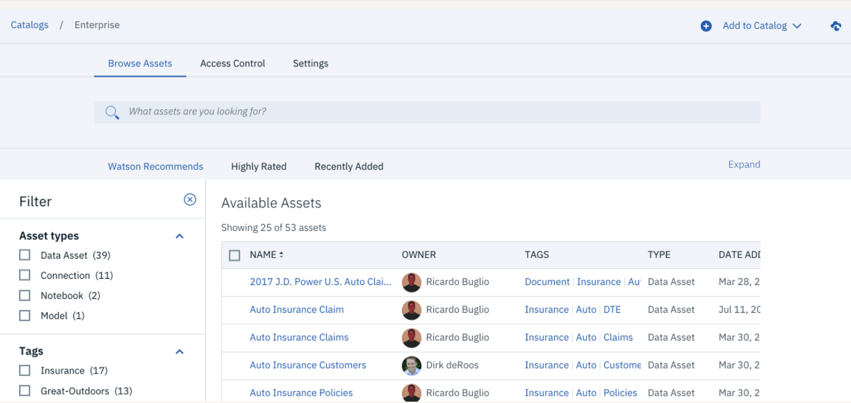
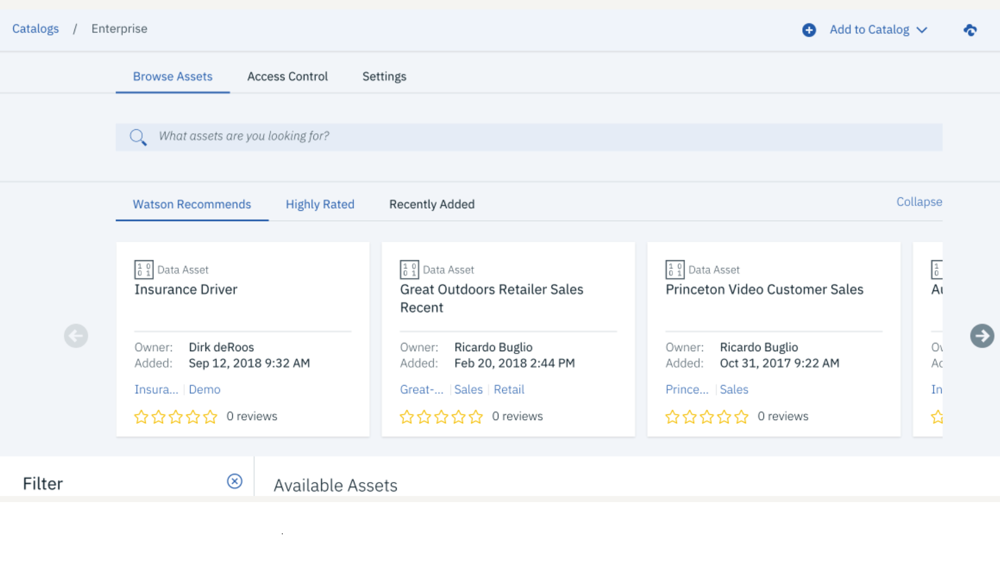
Watson Knowledge Catalog: Search and Explore

Slide 3
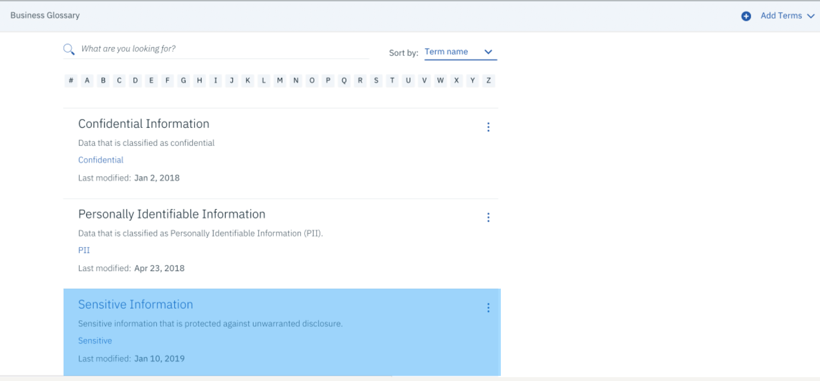
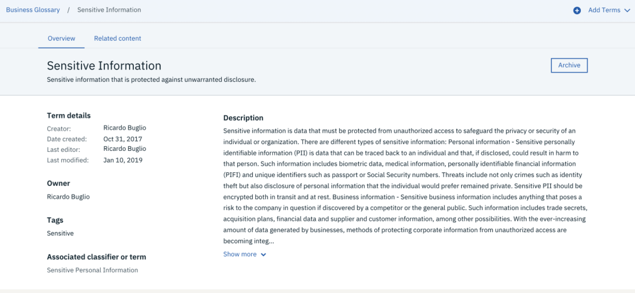
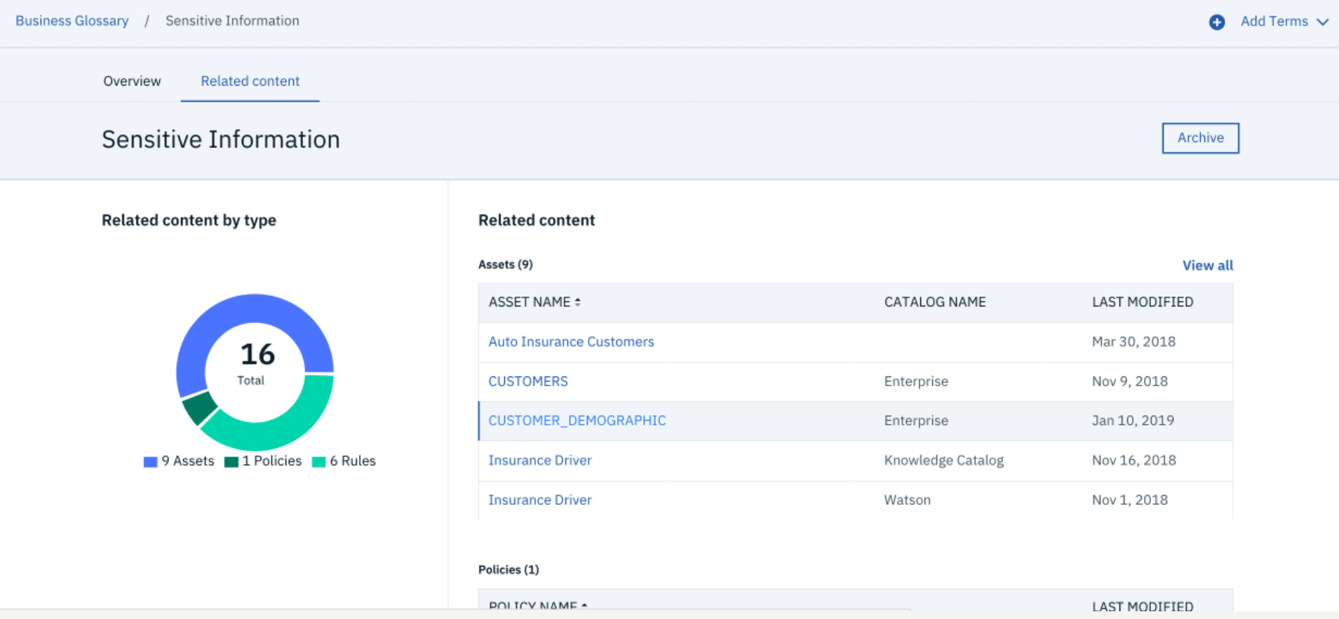
Watson Knowledge Catalog: Glossary Terms

Slide 4
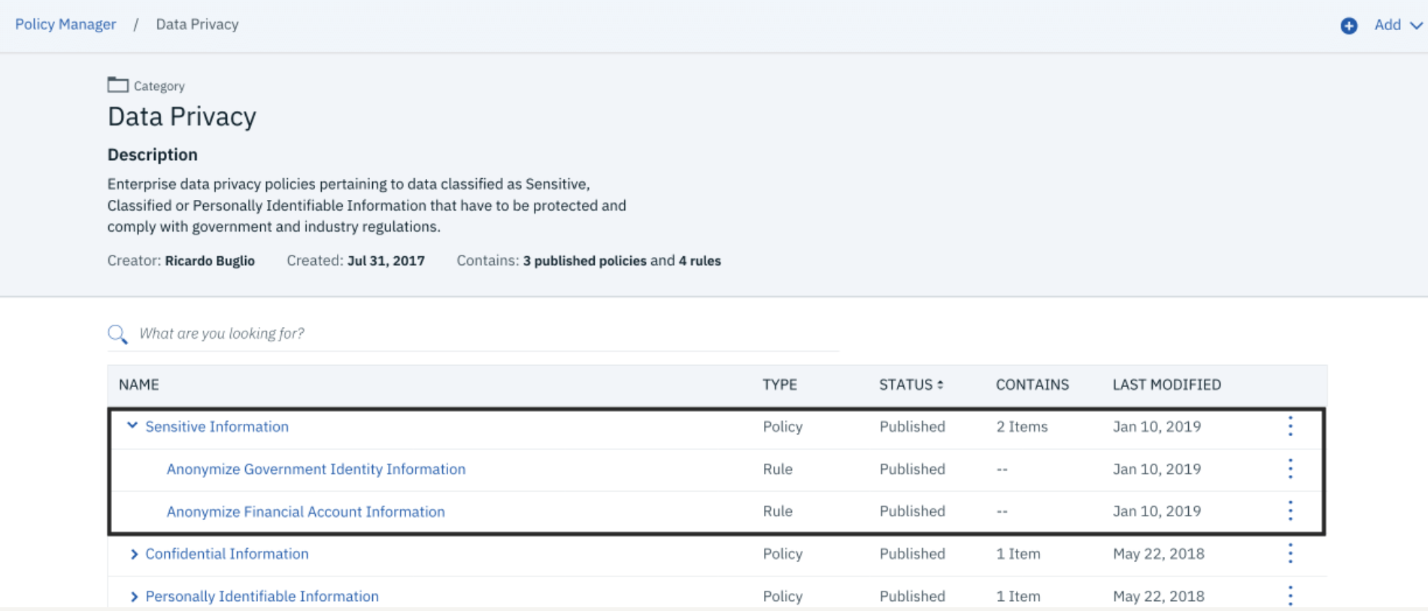
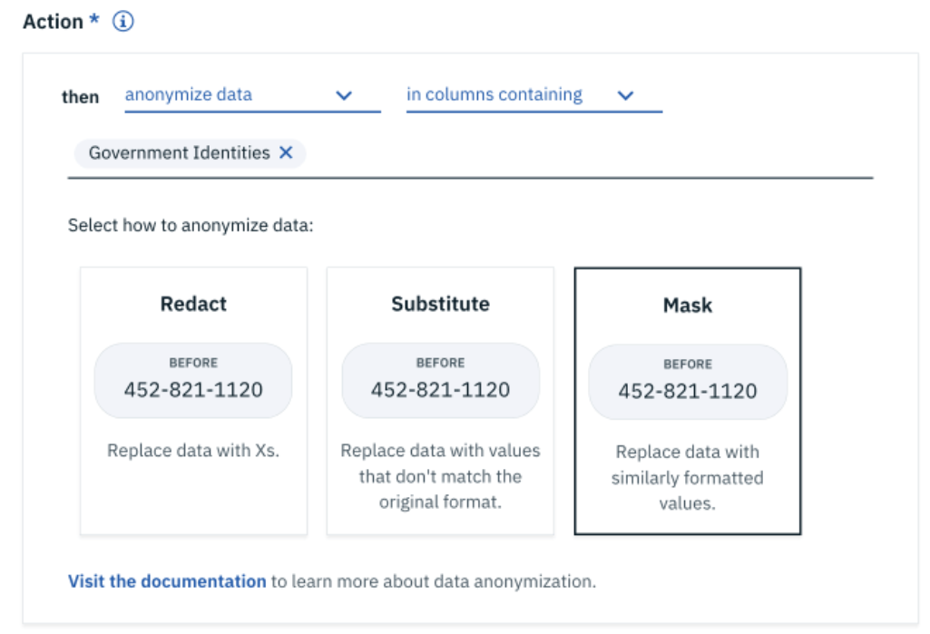
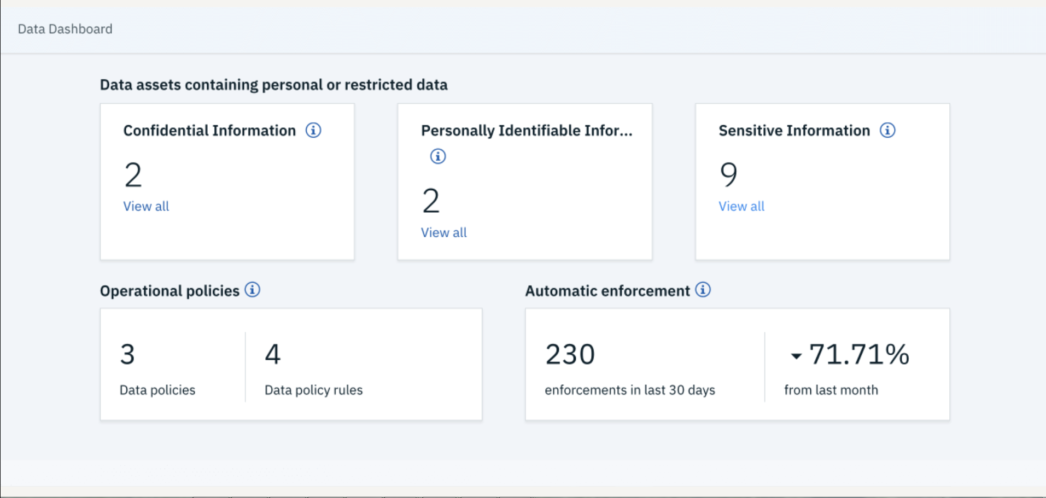
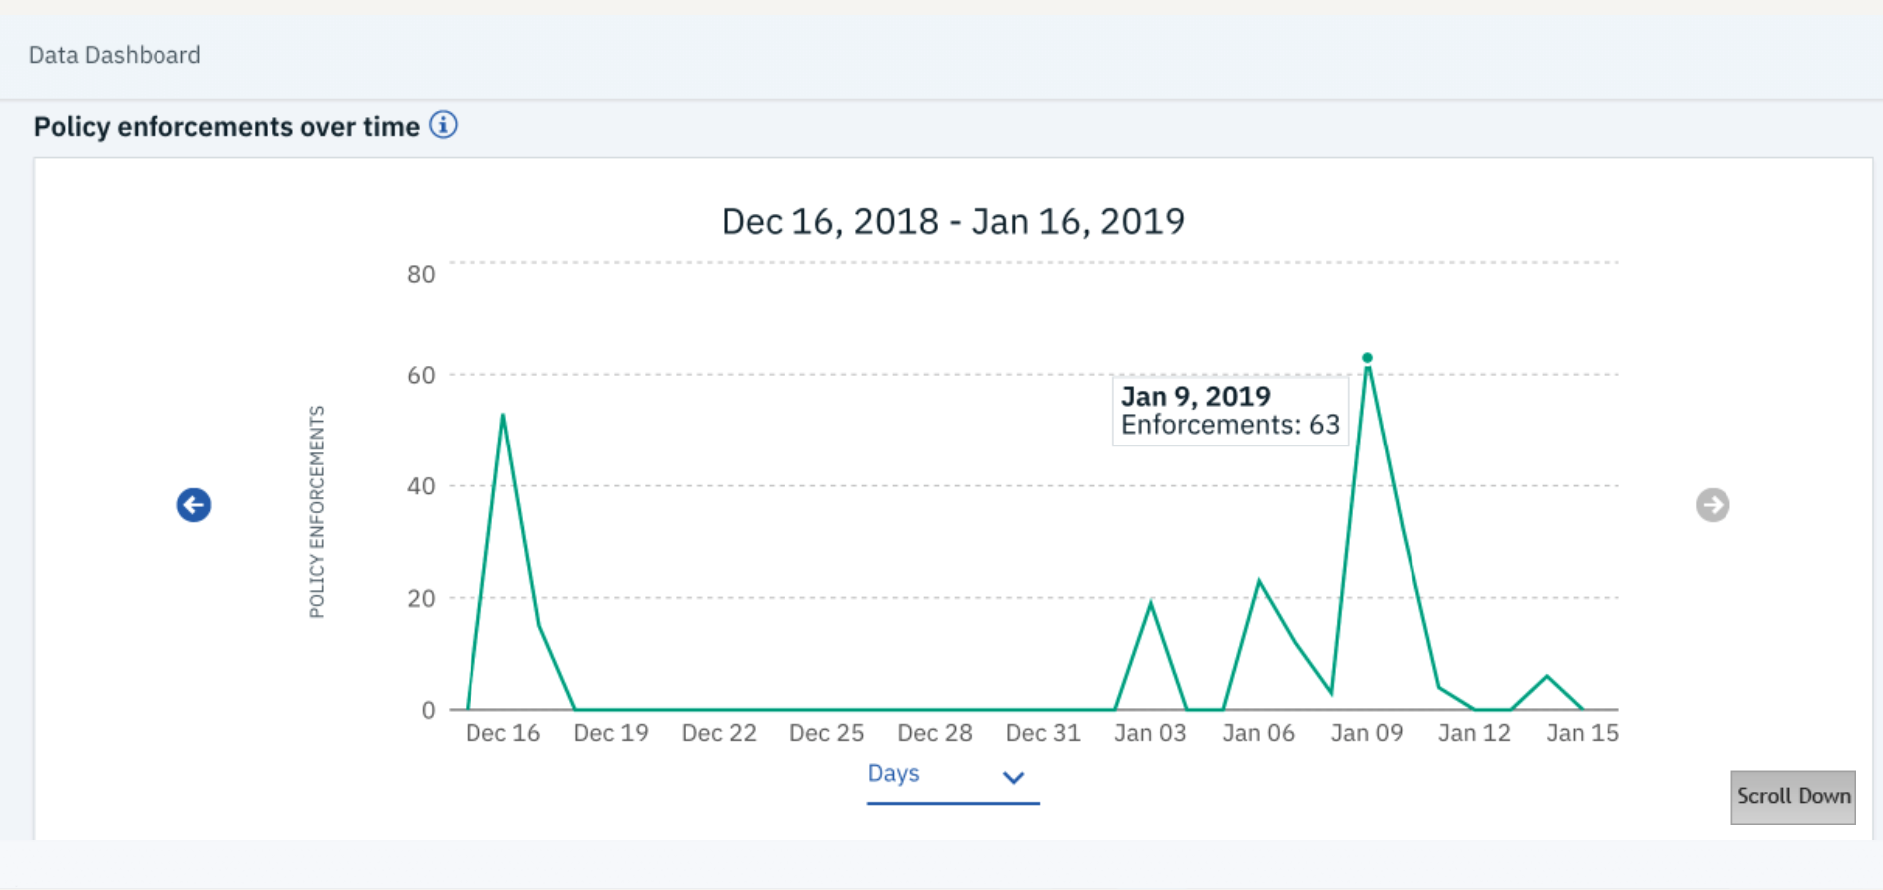
Watson Knowledge Catalog: Data Rules and Policies

Slide 5
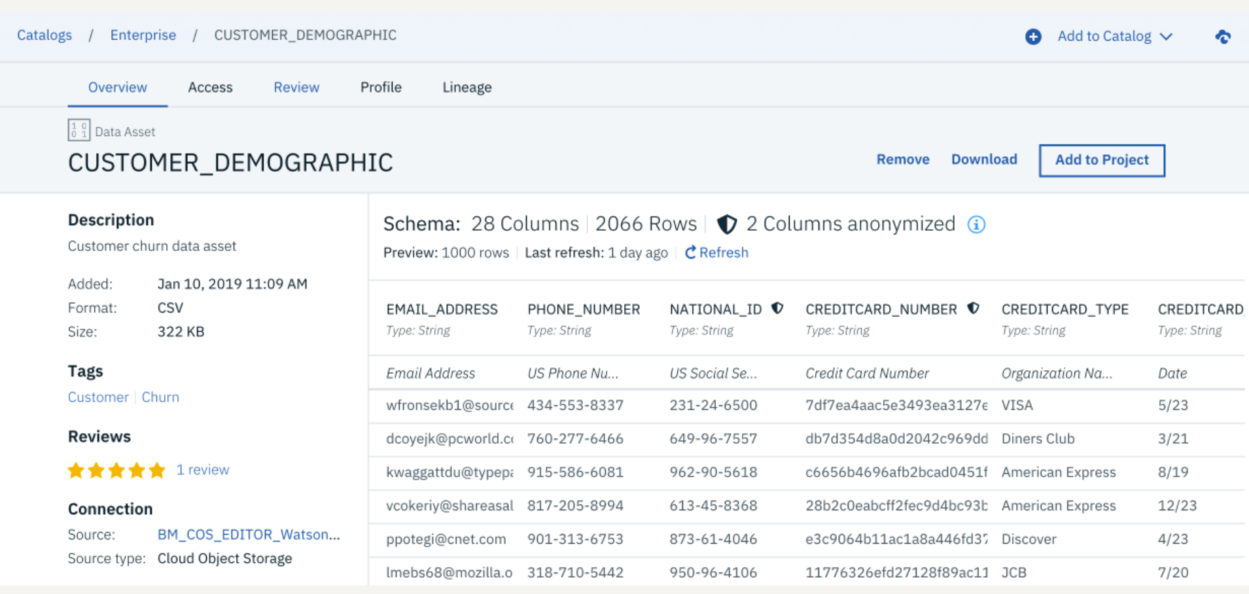
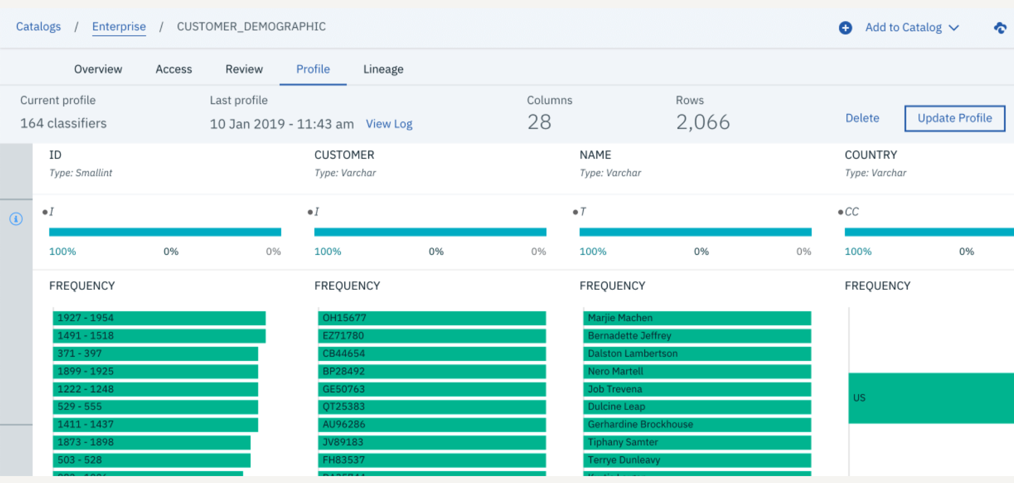
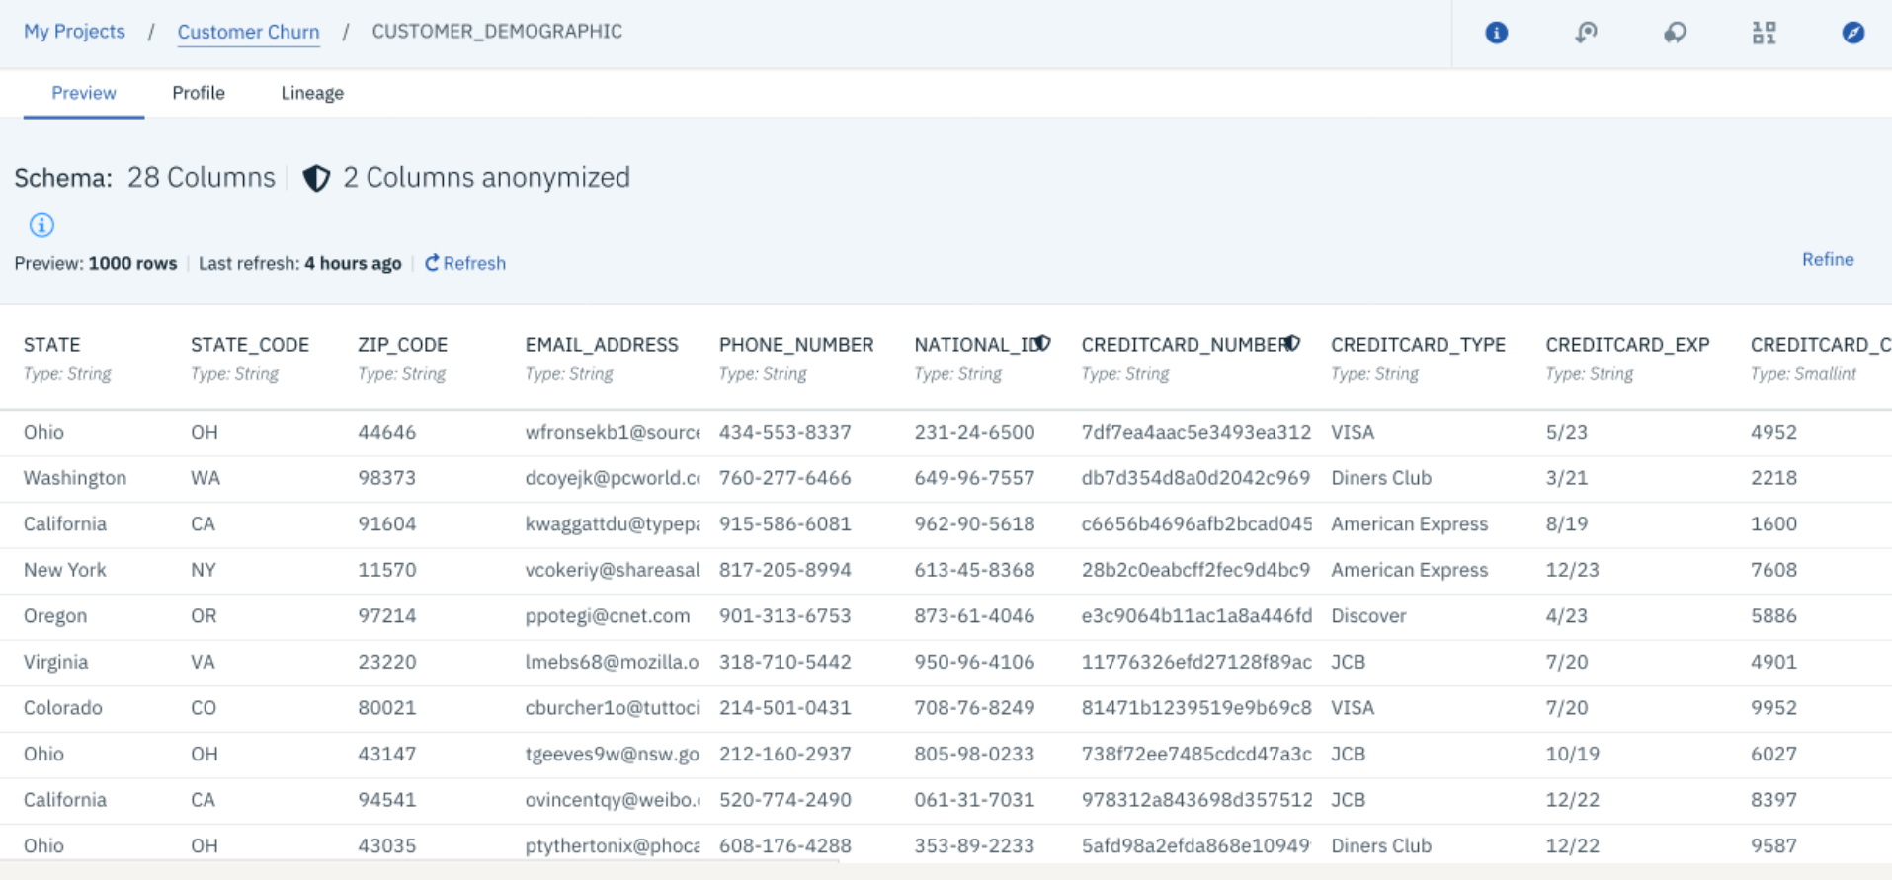
Watson Knowledge Catalog: Review and Understand

Slide 6
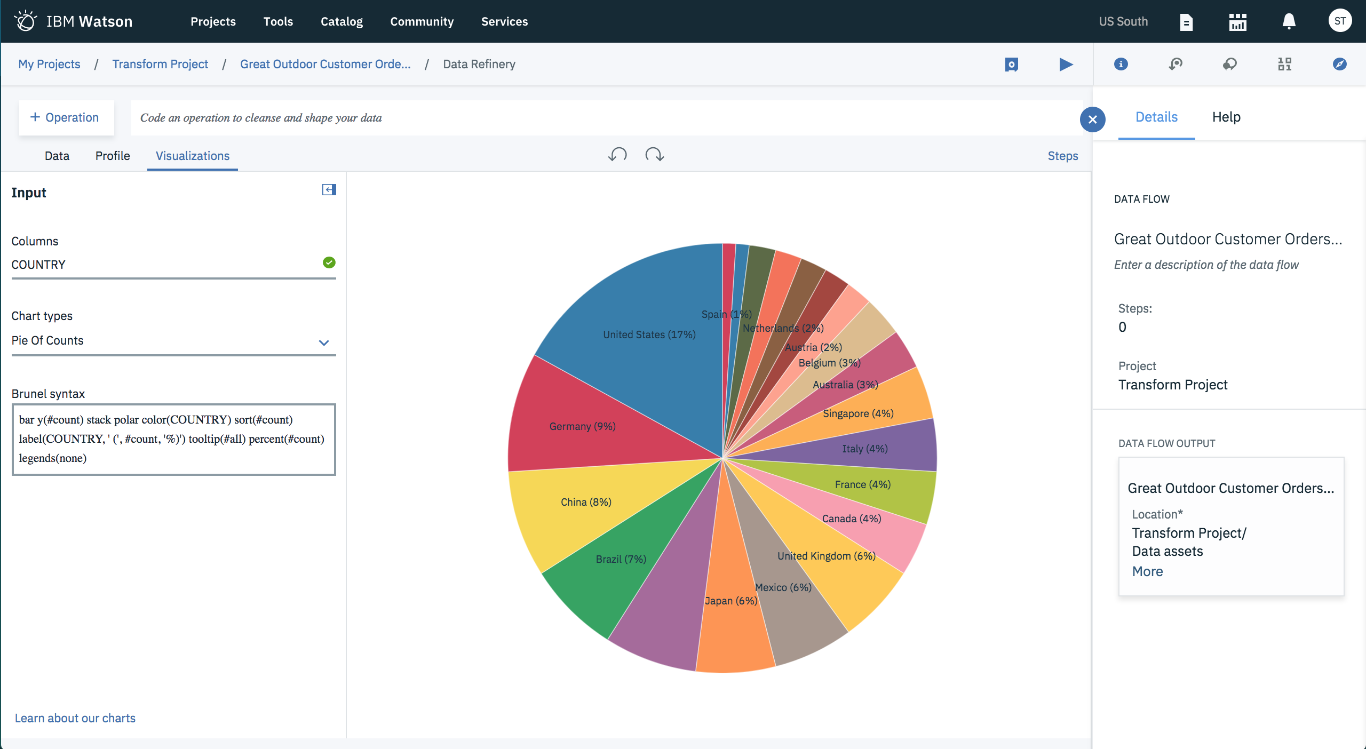
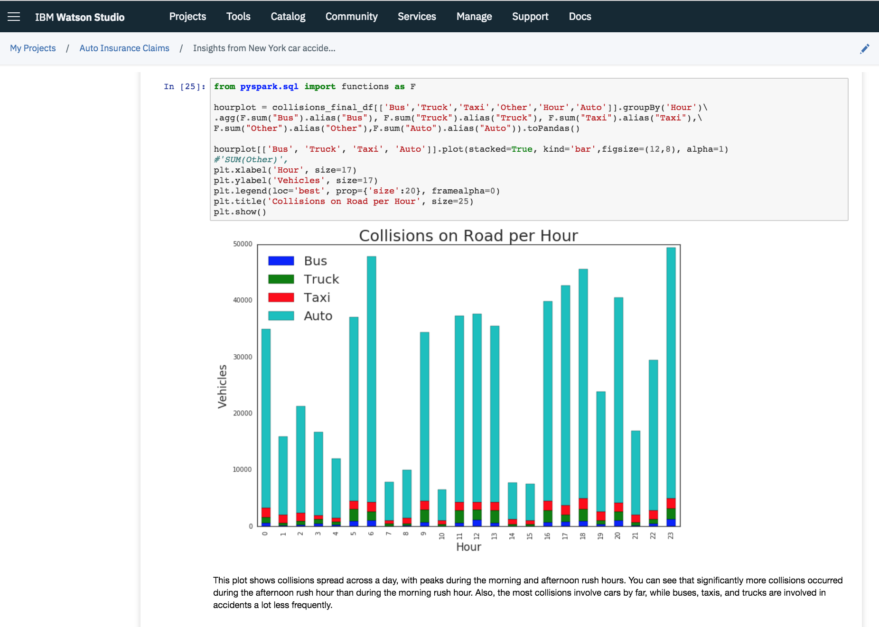
Watson Knowledge Catalog: Data Preparation & Data Science tools

Slide 7

Business Problems Solved by WKC
Problem #1: Inability to find the right data at the right time for reporting to the business and for creating models
Persona: Data Scientist or Business Analyst
Solution: Knowledge Catalog indexes and classifies data assets which can be be quickly found by Intelligent search algorithms that can guide your data scientists and BAs to find the best data for their purpose. Once found they can move/share the data into their AI / Analytics projects.
Value :Improve the findability and use of data assets for business analysis or model development
Problem #2: Inability to easily inventory data assets, document it and apply governance rules to protect data
Persona: Data Steward Solution: Knowledge Catalog provides an easy way to build and index all assets across your business functions & then enforce access and anonymization using policies & rules. Value: Intelligent data curation helps curate data faster and governed and protected data is made available to the business users to trust and use it with confidence.
Problem #3: Information locked away in department silos
Persona: Data Scientist or Business Analyst
Solution: Knowledge Catalog makes it easy for even unstructured knowledge to be shared and accessible across the enterprise. ‘Auto Profiling’ and ‘data connections’ to 60+ sources makes it easy to catalog and organize. Cataloging of data creates a ‘shop for data’ online shopping experience experience.
Value: Find and use data through self-service access to the data
Problem #4: Inability to deliver data efficiently and reliably to the business
Persona: Data Engineer
Solution: Knowledge Catalog provides self-service access to data. The business users no longer need to wait on IT to get the data they need and the Data Engineers can focus on the business critical tasks essential for business growth. CDO organization is directly in charge of the organization’s data mine.
Value: Quickly deliver data as and when new data sources are added to the data pipeline.
Problem #5: Business and Software teams not in sync in a project
Persona: Application Developer / Business Analyst
Solution: IBM Knowledge Catalog provides an intelligent business terms and tags that connects business with software / IT orgs so, that all are on the same page.
Value: Commonality between business and software teams.
7
Notes:
AI is all about the ability to build, deploy, catalog, and manage models, which is what IBM’s AI portfolio provides. It gives you the ability to:
BUILD models for making predictions. Watson Studio supports this.
DEPLOY to put custom models into production, in an application or business process. This is where the model starts to make predictions for the client’s business and it happens with Watson Machine Learning.
CATALOG for data discovery and activation. The Watson Knowledge Catalog allows users to access, curate, categorize, and share data and assets wherever they are.
MANAGE to operationalize and automate the management of models and tools across your business, with trust and transparency. IBM’s answer for that is Watson OpenScale.
This is the full stack of offerings which deliver the top rings of the AI ladder in Organize, Analyze, and Infuse which map really well to the AI ladder. The key here is that all of these offerings work together to get enterprise organizations to the top of the latter.
Watson Knowledge Catalog helps with that organize step with data profiling, quality and lineage, and data governance.
Watson Studio helps with the analyze step with data exploration, preparation, and model development.
Watson machine learning is the infuse step with model development and management provided by WML
and Watson openscale delivers measurement and tracking of those models
All of this together is our AI portfolio that you can access on the private cloud, on the public cloud, on prem, or on desktop.
Watson Application Services are packaged applications that we bundle together to provide the user with AI in a box.
AI Open Source Framework: This is, without a doubt, the future of the market. We built our AI portfolio on open source to make it secure and managed so that our clients can put it to use without the risk or extra cost.
IBM Cloud Private for Data: IBM’s AI portfolio is designed to deploy on our unifying platform. This is our prescriptive approach—one platform, supporting a multi-cloud environment, that brings all of a client’s data and AI capabilities into one set of collaborative workflows and governance capabilities.

Slide 8





Use Cases being Implemented by our Clients
Key Benefits
Augmented Data Management
Data Prep & AI-powered Findability
Policy Activation for Data Governance
AI Governance
Automate the collection, curation and understanding of your data. Detect business entities, quality, bias and validity of you data to build an automatic level trust in your data.
Automate the mundane
Utilize automatic suggestions on how data can be best prepared for use. Intelligent suggestions to guide users to the best data for faster, smarter analytics and AI.
Use the data to get the data
Autonomous enforcement of data and AI governance policies, providing automatic decisions to mask and protect data for a particular purpose.
Activate your governance program
Support your adoption and roll out of trusted AI. Ensure that your models remain compliant for quality and bias.
Govern AI across your enterprise
IBM Cloud / March,2019/ © 2019 IBM Corporation
8
Notes:
The use cases span Collecting, Discovering, Governing and Using data.
The top 4 use cases:
Democratize Your Data: break down data silos by empowering users through governed and trusted self-service access to data wherever it lives
Broaden Analytic Capabilities: bring together structured and unstructured data, information assets and AI models, and enrich with metadata to allow knowledge workers to work across more disparate data types and sources than ever before to find new insights
Monetize data assets through AI: quick and easy access to seamlessly integrated tools for data preparation, AI and machine learning to drive business innovation
Regulations and Compliance: understand what is in your data, where they come from and whether they contain sensitive data
▪

